Slide 1
The Jasmine Effect
Automate; Don't Panic.

Slide 2
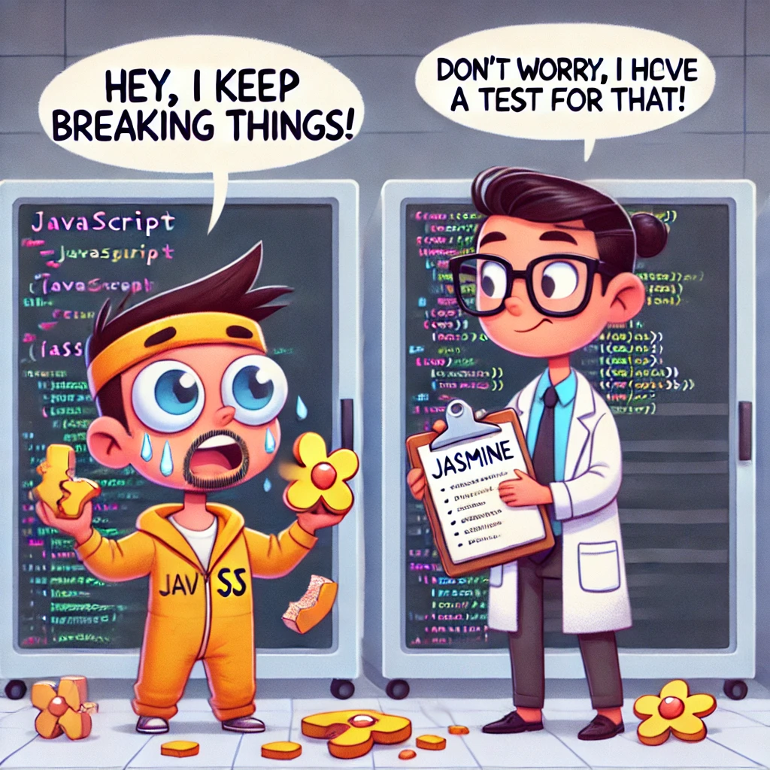
Jasmine’s Got Your Back
Jasmine is a lightweight testing framework for JavaScript.
Think of it as a detective who catches bugs before they cause trouble.
Automated, consistent testing.
Catching bugs early in development.
Improving script quality and maintainability.

Slide 3

Prototype
Created by Sam Stephenson in 2005 to simplify and improve the process of writing JavaScript for web development.
It provided various utilities and extensions to the JavaScript language, such as:
Extending built-in JavaScript objects like Array, String, and Function.
Easier DOM traversal and manipulation.
Cross-browser support.

Slide 4
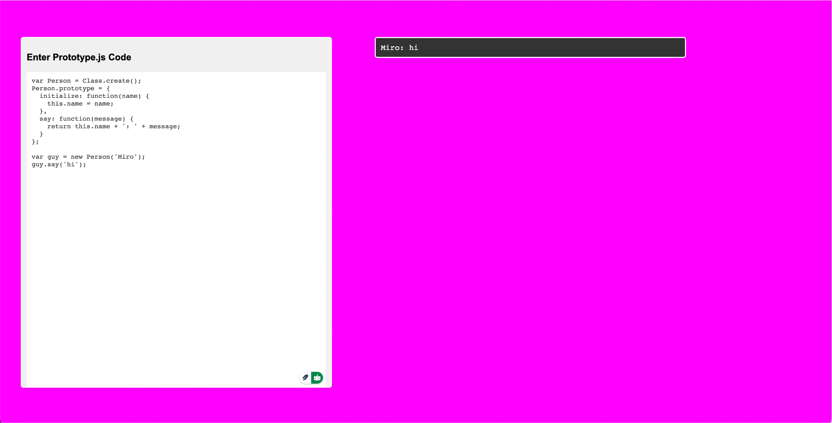
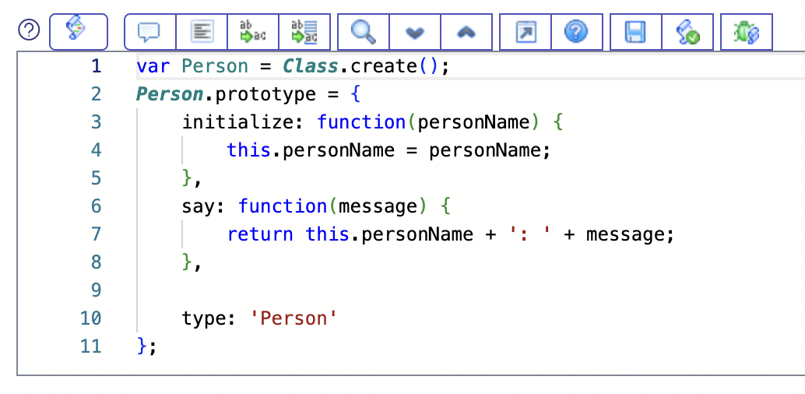
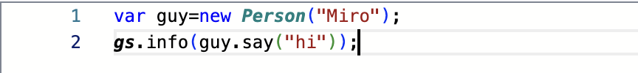
ServiceNow's Secret Sauce

Slide 5
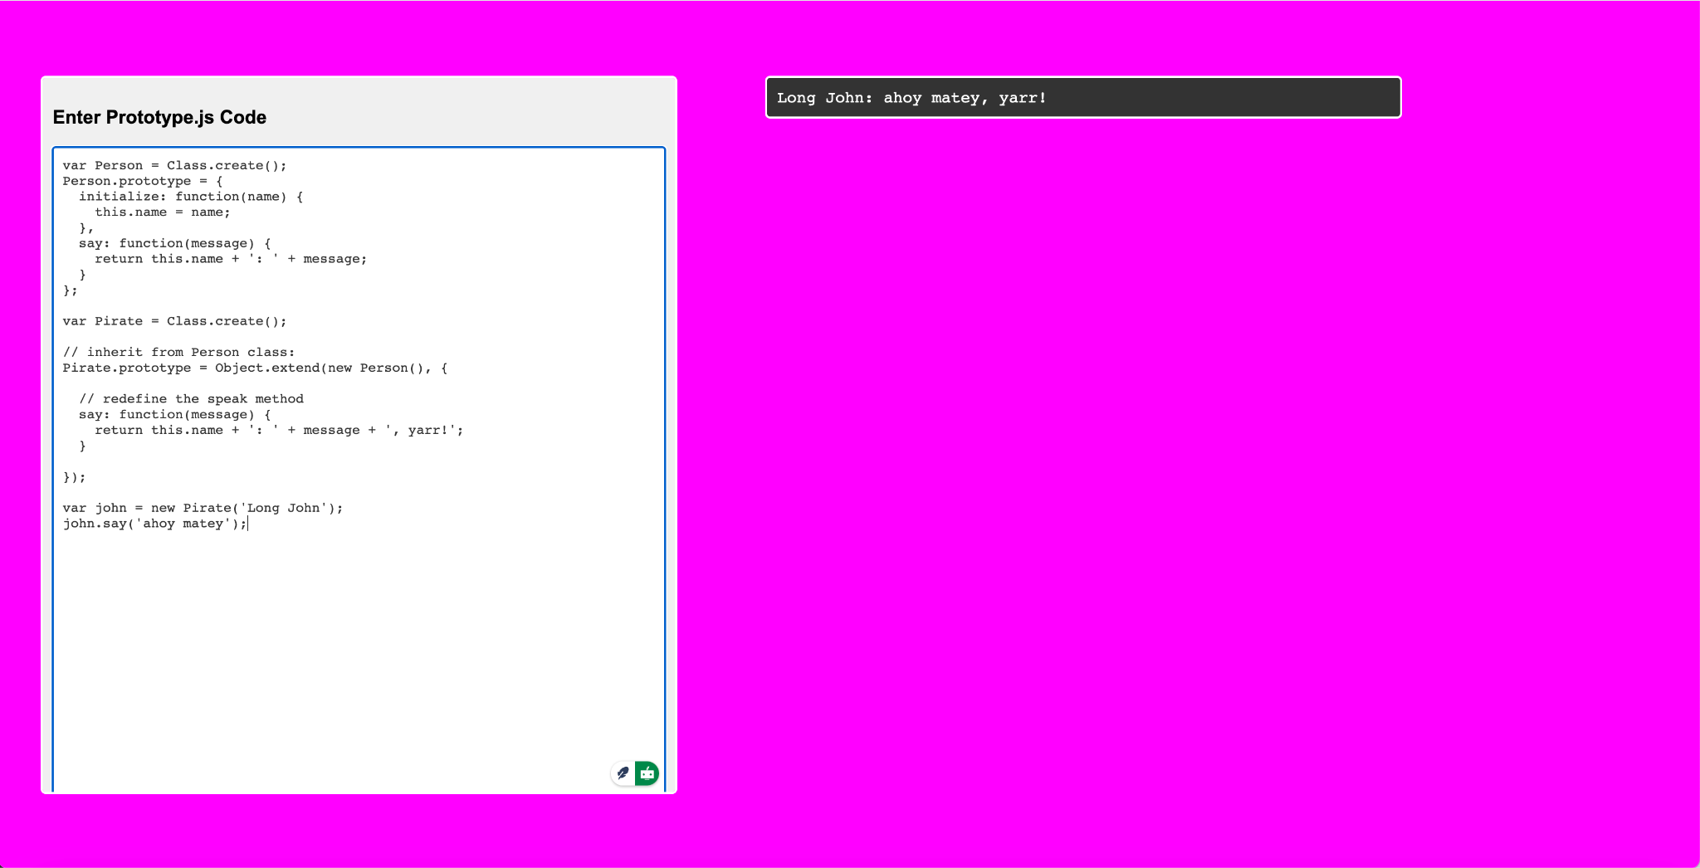
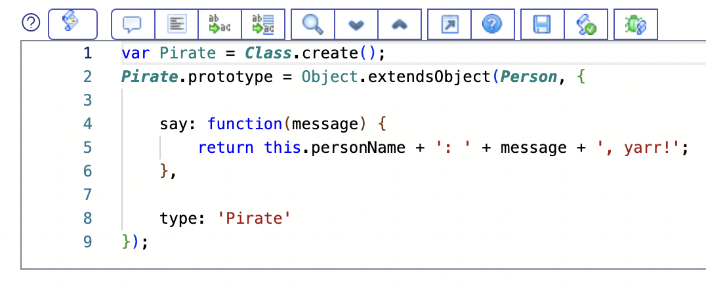

ServiceNow's Secret Sauce

Slide 6
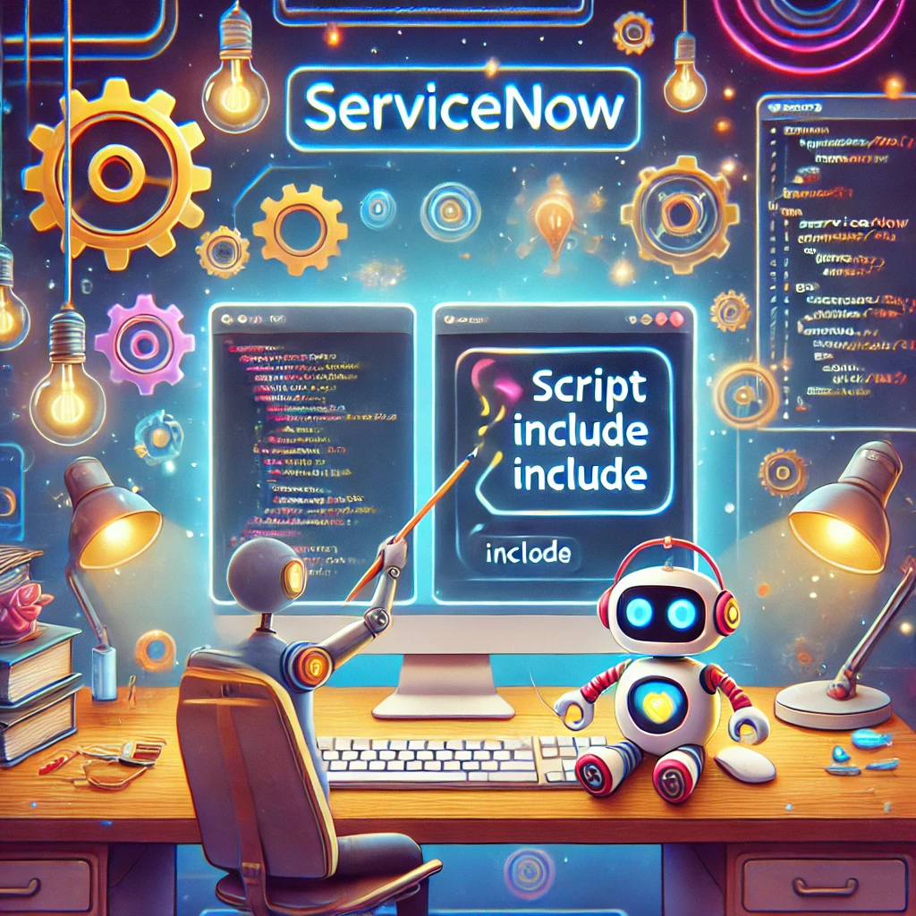
Script Includes
Script Includes are reusable server-side script logic that define a function or class.
Script Includes execute their script logic only when explicitly called by other scripts.
They are a powerful way to write code that can be called from multiple places, making your instance more modular, maintainable, and efficient.

Slide 7
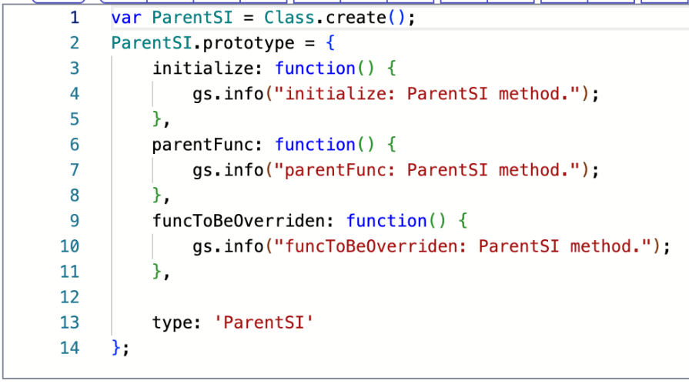
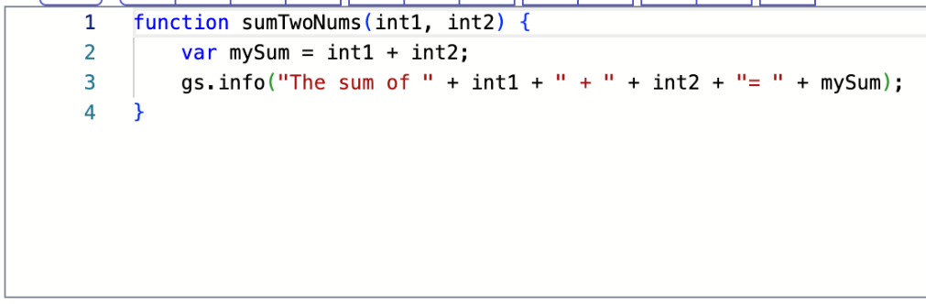
Script Includes Patterns

Slide 8
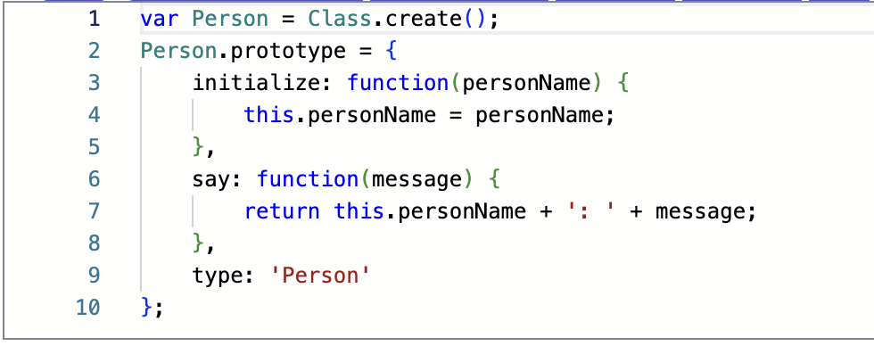
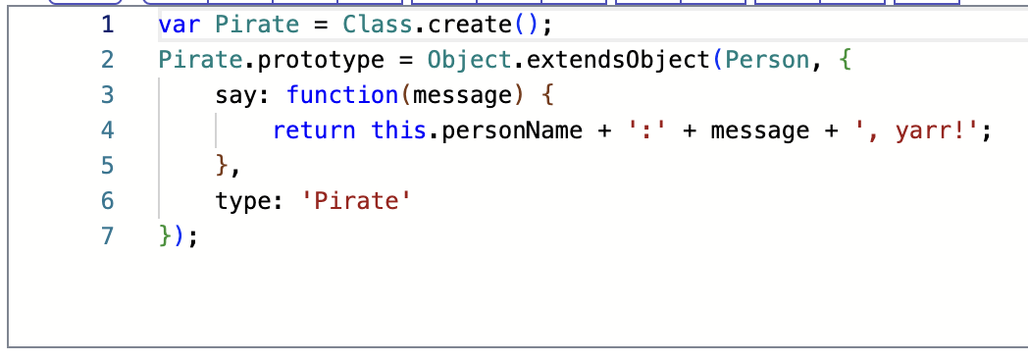
Script Includes Patterns

Slide 9
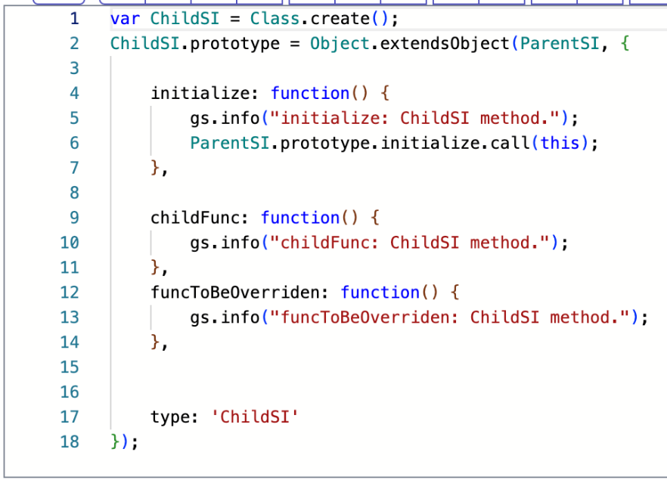
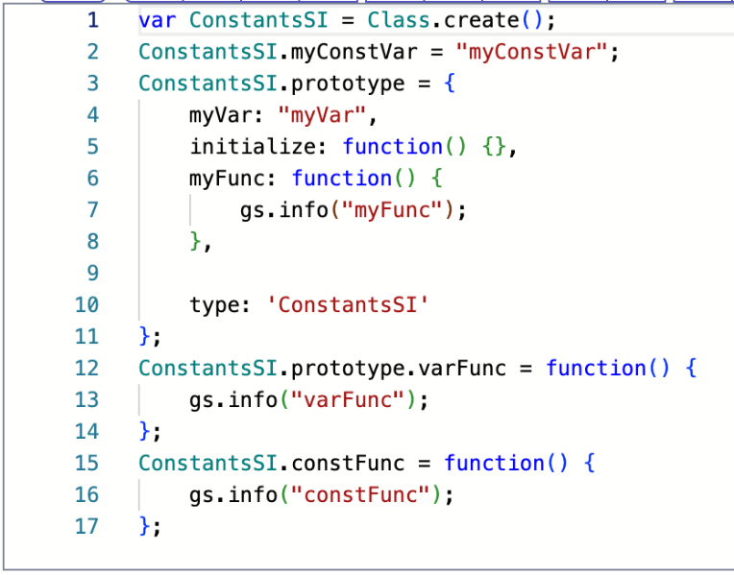
Script Includes Patterns

Slide 10
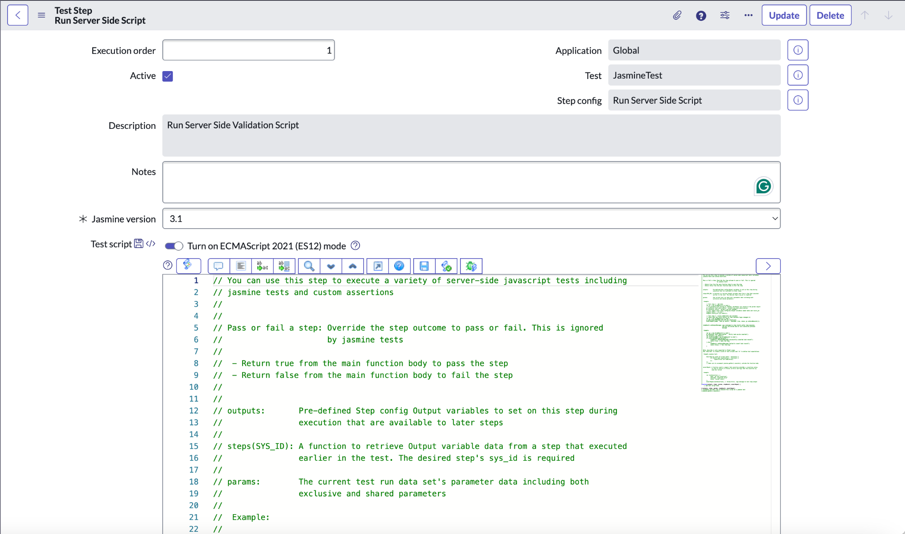
Run Server Side Script

Slide 11
References
http://prototypejs.org/
https://beingfluid.github.io/ptototypejstest/
Objects: Making It A Little Easier…
Script Includes
NOWCommunity Live Stream - Code Decoded - Using a Constants script include
Live Coding Happy Hour for 2017-02-10 - Server Scripts with Automated Test Framework
Unit testing your Javascript with jasmine
https://jasmine.github.io/

